Slide 1
Cancer Cells Growing in Petri Dish Jaden Stanford & Anthony Zaitsev
Agent-Based Model

Slide 2
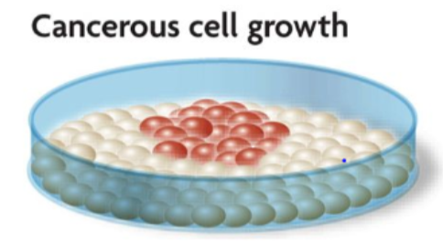
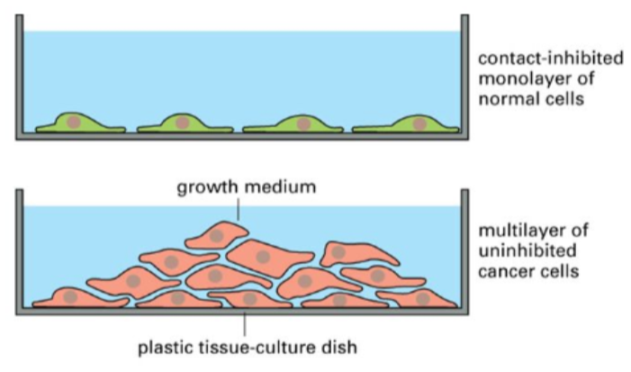
What is the Model?
Cancer cells growing in petri dish
Cells as agents (patches)
Cells growing to fill petri dish
Form monolayer
Cling to sides
Cell death/lifetime
ABM importance:
Analyze cell growth patterns
Factors influence proliferation

Slide 3
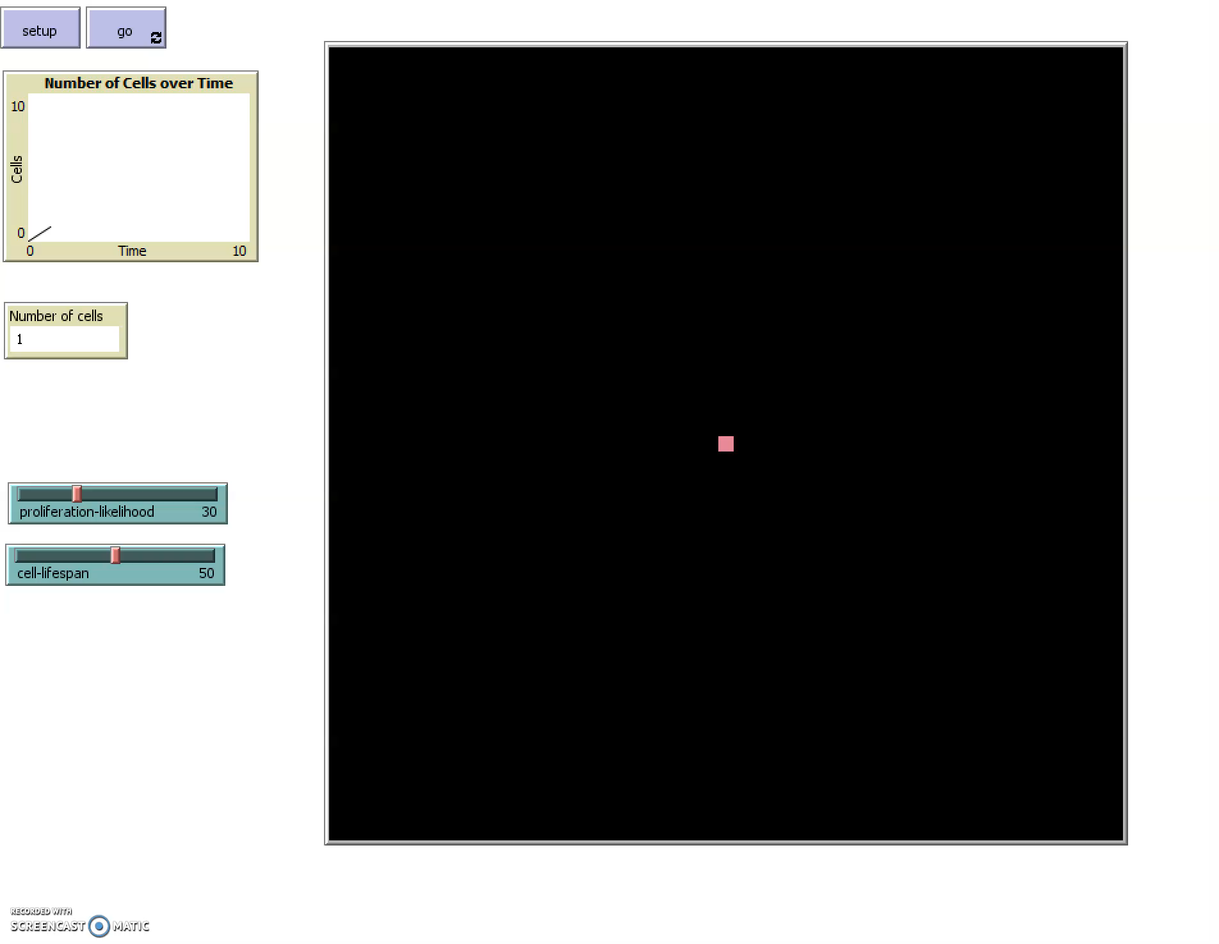

Slide 4
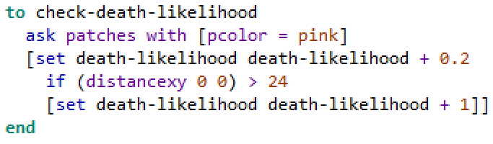
Model Description
Assumptions:
No overlap
Cells fill petri dish
On-lattice
Cells divide if there’s space
Cell Death Likelihood
Proliferation - Likelihood
Distance from dish
Observer control
lifetime
randomization
randomization

Slide 5


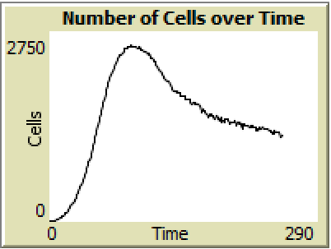
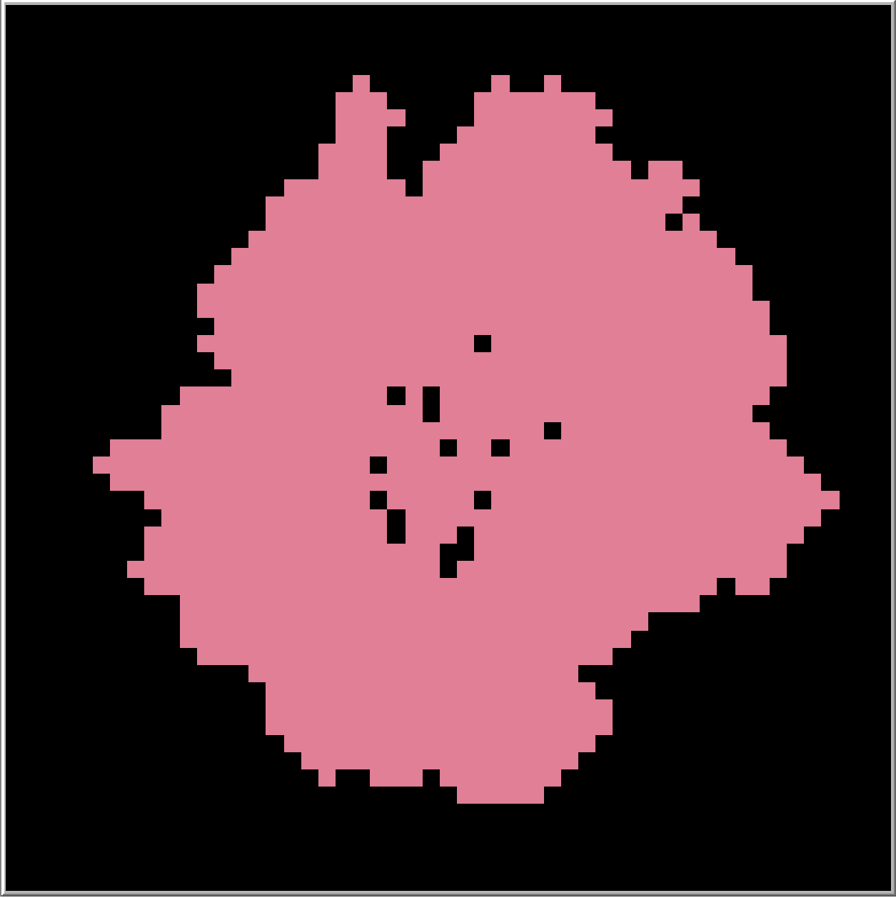
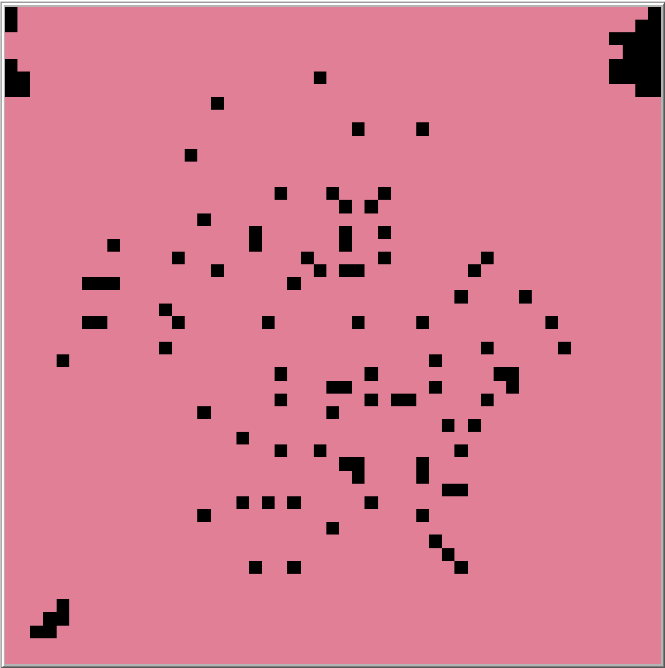
Data
Quantification: cell death likelihood , proliferation likelihood, lifespan
Proliferation likelihood higher:
Cell lifespan higher:
Proliferation likelihood around 30 and cell lifespan around 50
Looking for:
Complete fill (or almost)
Plateau
Eventual death
lower:
lower:

Slide 6
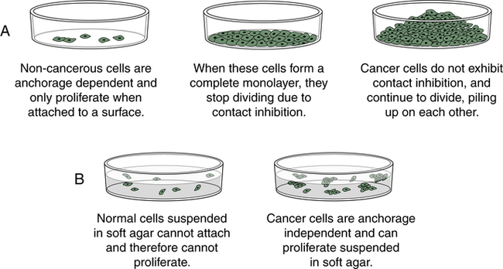
Conclusions
shows cell growth, but inaccurate
Possible next steps:
Nutrients in broth
Growth factors
3-D model
Layering?
More detail

